Slide 1

Meet the Teacher
2026-2027
Jesse Gray Primary School
Mrs Garton-Wills
Class 3J
Mr Hassall
Class 3G

Slide 2
Outcomes of the meeting
An opportunity for you to find out about…
curriculum in Year 3
Values and Behaviour System
PE/PA
Homework at Jesse Gray
OPAL Play
Personal Belongings

Slide 3
Our curriculum
To help keep you up to date with what we are learning in class we will send you….
A mindmap each term telling you about the curriculum for the term.
A bookwarmer introducing our new class text.
Weekly Seesaw messages about what we have learnt and what we will be learning.

Slide 4
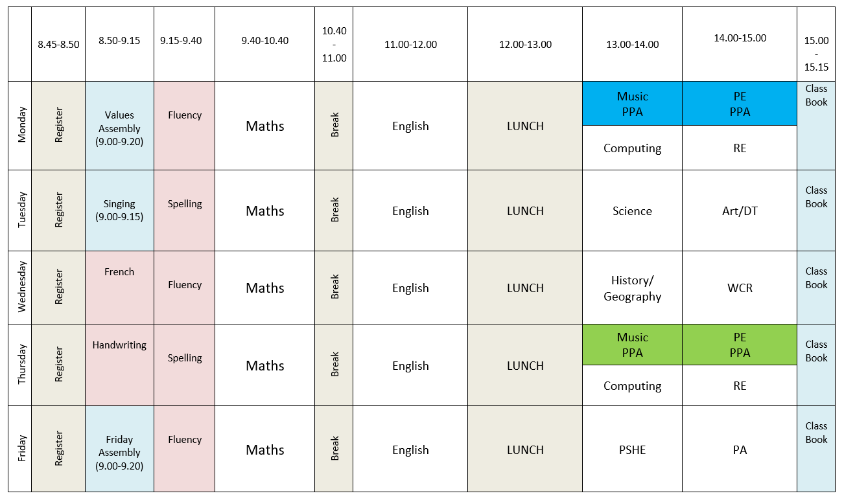

Slide 5
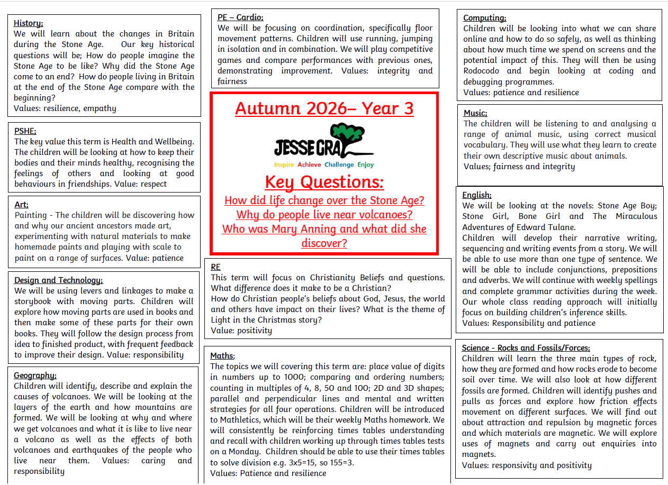

Slide 6
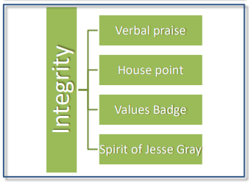
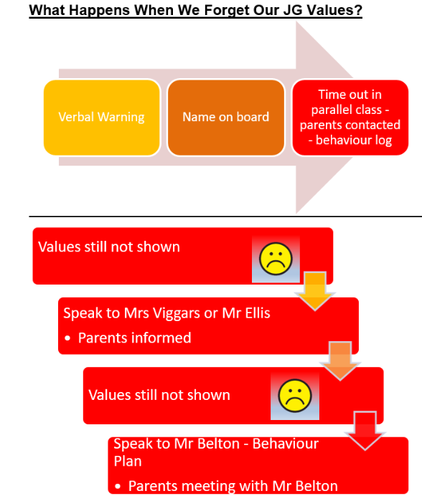
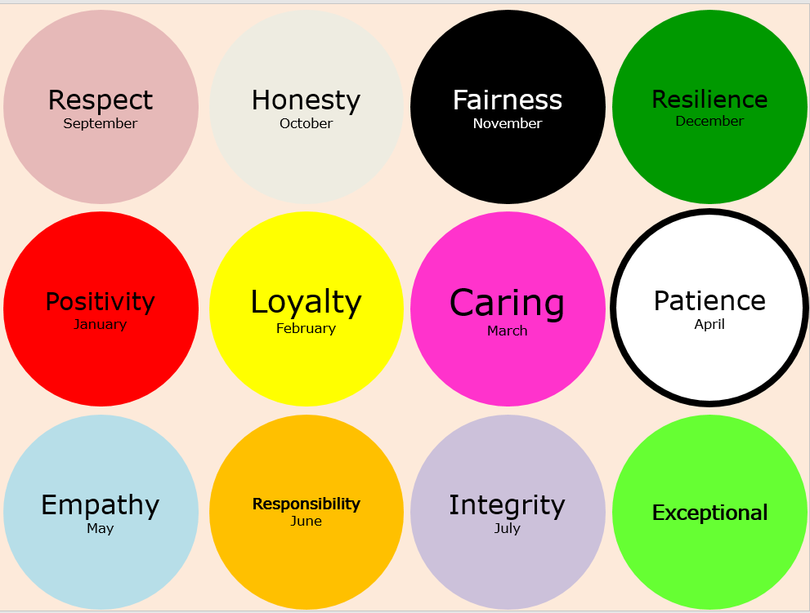
Values and
Behaviour System

Slide 7

PE / PA
One hour with Mr Smith each week on Monday or Thursdays alternating
One hour with class teacher each week on Fridays
PE Kit: Black shorts/jogging bottoms. White T-shirt. Red jumper. Trainers/plimsoles. Ear rings must be removed or be removable on PE/PA days
Children must have PE kit in school and will not be allowed to participate if they are not correctly dressed.
PE kit will be sent home half termly.

Slide 8

Homework
Reading. Please record all reading in your child’s planner. They will be monitored by class teachers and Mr Belton! They do not need to read to an adult.
Year 3 children are responsible for swapping their own books in the library or in the classroom.
Spellings – Friday
Accelerated Reader Quizzes – checked on a Friday
TT Rockstars - Friday
Maths fluency – Friday

Slide 9
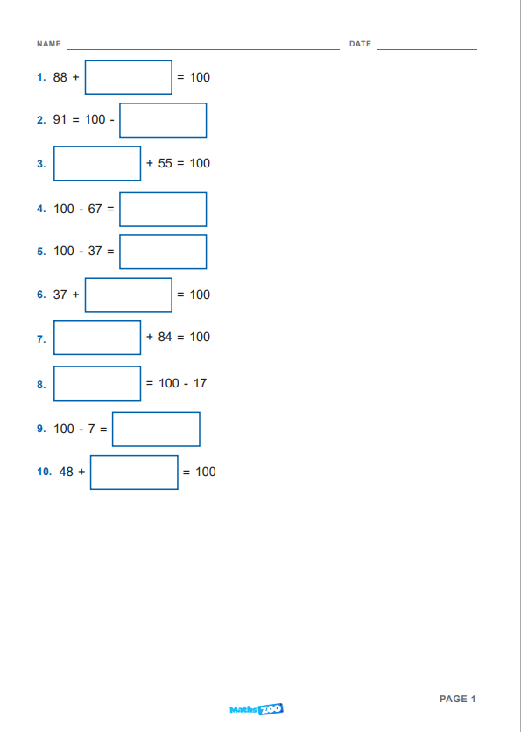
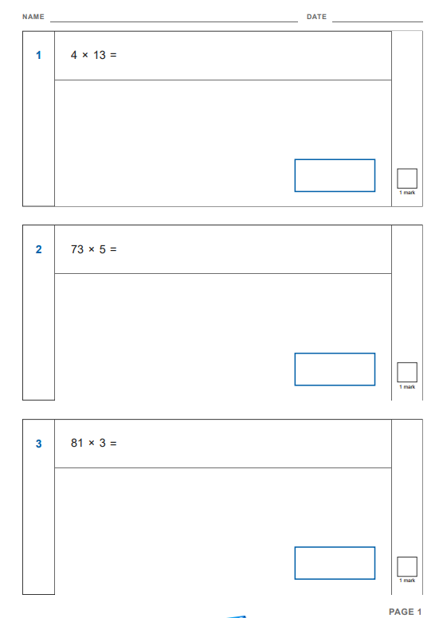
Maths homework
Complete at home and mark at school

Slide 10
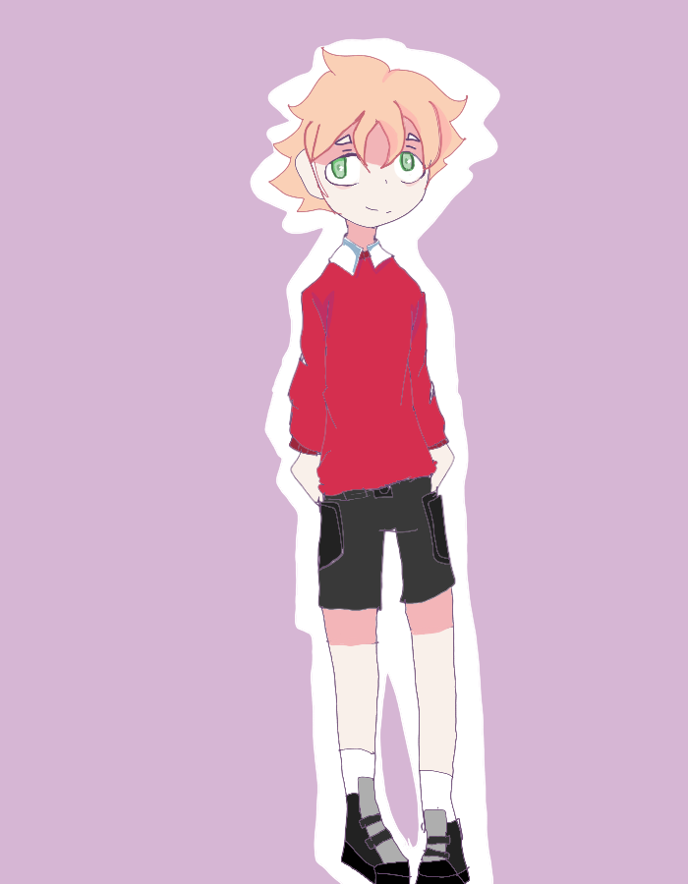
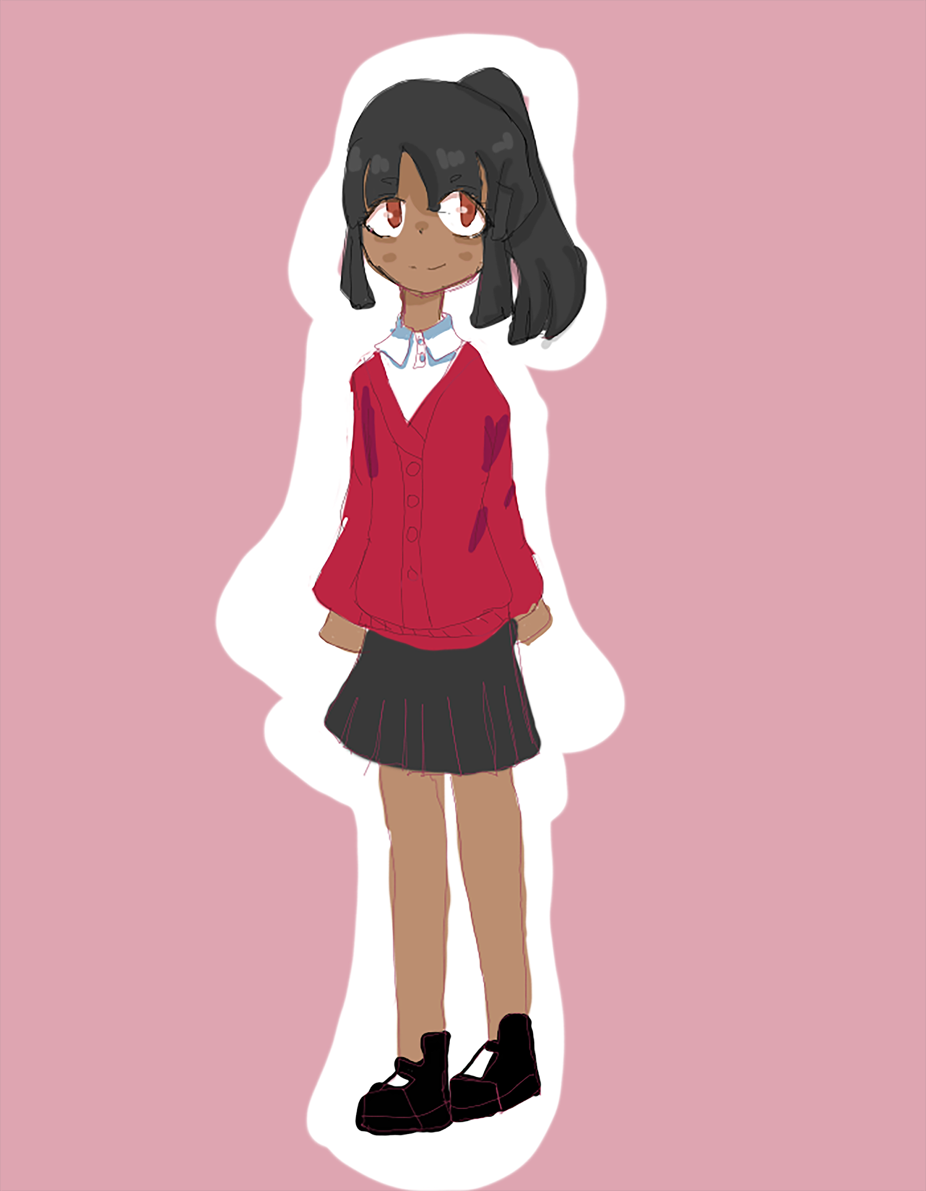
School Uniform
A few reminders…
BLACK SHOES - Fashion shoes such as trainers, and footwear with flashing lights; flimsy, high-heeled, backless sandals or shoes with high heels/platforms are not allowed for safety reasons. Trainers are to be used for PE only, not as normal day wear
OUTDOOR COAT - all children require a warm, waterproof outdoor coat EVERYDAY!
LONG HAIR - we advise children with long hair to wear it tied back at school for safety or head lice prevention reasons. They must do this for PE and swimming (required by swimming pool) please note also that swimming pool regulations require a one piece swimming costume for girls
JEWELLERY - No jewellery is allowed, except for watches and small studs for pierced ears. This is for safety reasons and to avoid the disappointment of loss or damage. No nail varnish is to be worn.
Smart watches and devices are not permitted.
SUN HATS - The school provides the children’s first school sun hat, which the children are required to wear outside during playtimes and all outdoor activities from when we return from the Easter holidays until we break up for October Half Term. Replacements can be purchased from school office. FS2-Year 2 wear the legionnaire style red cap with neck protection. KS2 children can choose a black baseball ca
PLEASE NAME EVERYTHING

Slide 11


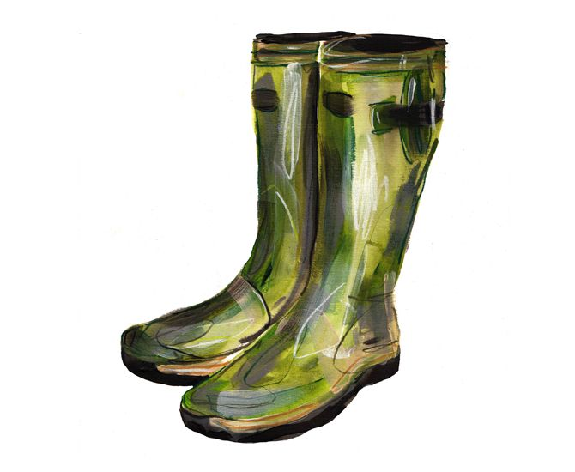
OPAL Play
Our aim is to use the outside area everyday!
All children wear wellies from October Half term until it is dry in the Summer Term. Please send in warm socks to help keep feet warm and stop wellies rubbing!
All children are encouraged to bring in waterproof clothing for wet days/muddy days.
All of the above must be named!

Slide 12

Personal Belongings
LABEL IT! If it comes to school, put a name on it and we can return it to its rightful owner. We do not have Lost Property. All unnamed items are recycled at the end of the week.
Please do not bring toys etc to school as we cannot guarantee they will not be damaged or lost.

Slide 13
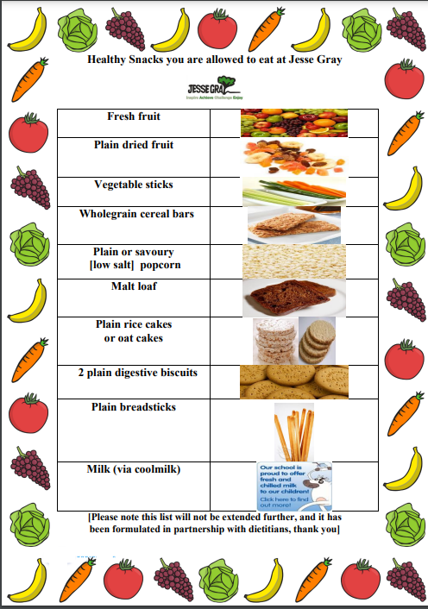
Snacks
Please ensure you select a snack from our Healthy Snacks list if sending a snack from home. This has been composed in consultation with dieticians.

